Slide 1
The approach — 7 phases
1
2
3
4
4.5
5
6
Define gel point
Prepare + synthetic
Quality gate
Candidate methods
Physics-conditioned
Score methods
Pick & deploy
›
›
›
›
›
›
G′/G″ crossover
known-answer clot
drop noisy windows
Fourier·CWT·DWT
physics→wavelet
9 criteria + gel point
the winner
Phase 7 (not shown): one donor — JUN18 — end to end.

Slide 2
The 7 test protocols — and which one gives a gel point
the rheometer runs different tests; only some let blood clot naturally
① Progressive thickening — blood clots naturally
② Imposed transient — blood is driven
Blood is left to structure over time, so a real liquid→gel transition happens → the G′/G″ crossover is detectable.
The rheometer forces an oscillation or jump, so viscosity spikes then decays — there's no natural clot instant to report.
✓
helton
✕
step
step-up/down in shear rate
THE key protocol — 20 clean crossovers, more than all others combined
✕
cessation
flow suddenly stopped
✓
(slow LAOS)
✕
reversal
flow direction reversed
occasionally thickens enough to show a crossover
✕
LAOS / UDLAOS
large-amplitude oscillation
✕
SRFS
stress/strain-rate sweep
→ where the PHYSICAL gel point comes from
→ blank on the readout (not faked)
This is why only ~49 of 267 signals give a clean gel point — it's a protocol-type fact, not a failure.
Notes:
KEY SLIDE for the rheologist. Two protocol types: progressive-thickening (helton) gives a real gel point; imposed-transient (step/cessation/etc.) doesn't. Helton alone gives 20 of the clean crossovers. This explains WHY only 49 signals have a clean crossover - it's physics, not a weakness.

Slide 3
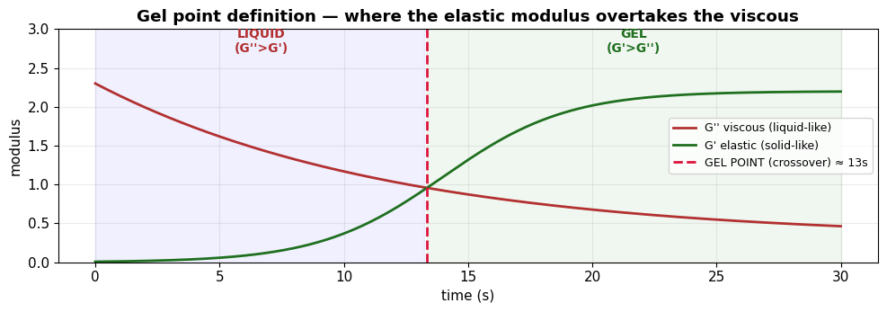
1
Phase 1 — Define the Gel Point
the target: where elastic G′ overtakes viscous G″ (liquid→gel)
The definition
G′ = storage (solid/elastic).
G″ = loss (liquid/viscous).
Liquid: G″ > G′.
Gel: G′ > G″.
Crossover (δ=45°) = the gel point.
Defined FIRST because it's the target every method is judged against.

Slide 4
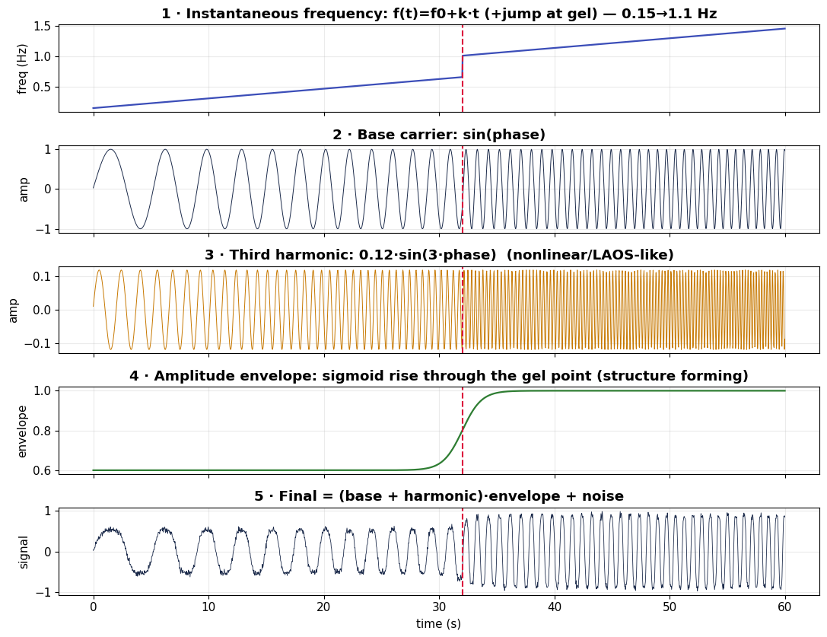
2
Phase 2 — The Synthetic Clot (how it's built)
frequency chirp × envelope + 3rd-harmonic + noise, gel placed at 32 s
Formula
1 · freq ramp: f(t)=f₀+k·t
(+jump at gel) → stiffening
2 · base carrier: sin(φ)
3 · 3rd harmonic: 0.12·sin(3φ)
→ nonlinear/LAOS-like
4 · envelope: sigmoid rise
→ structure forming
5 · +measurement noise
WHY: real blood has no answer key. A placed gel point makes each method's error measurable in seconds.

Slide 5
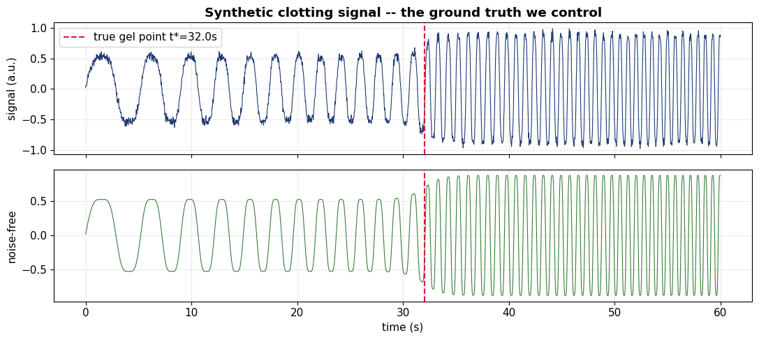
2
Phase 2 — Synthetic Clot (finished signal)
red line = the known gel point at 32 s

Slide 6
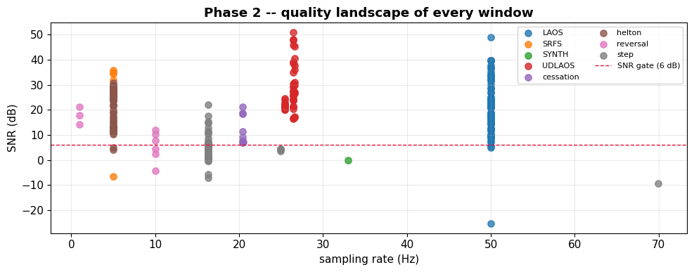
3
Phase 3 — Signal Quality Audit
gate at 6 dB SNR; 224 of 268 windows pass

Slide 7
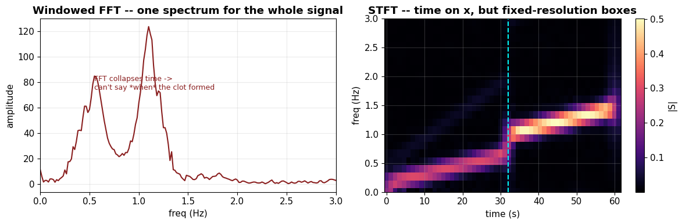
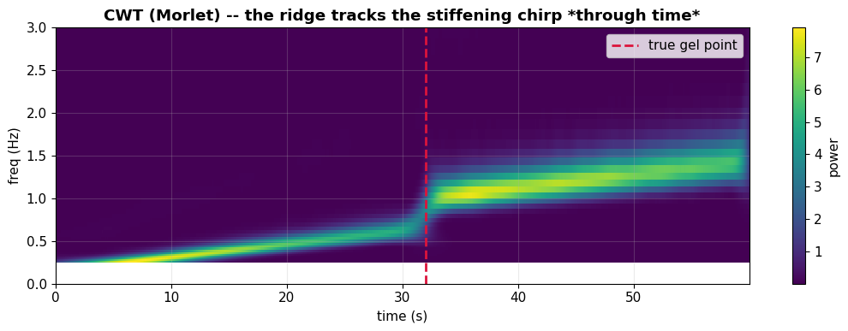
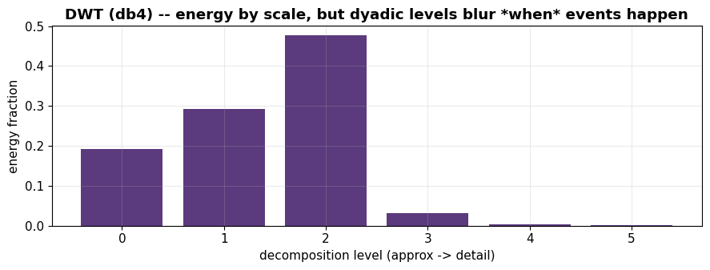
4
Phase 4 — Candidate Detection Methods
three families on the same signal — the visual difference is the whole story
Fourier (FFT/STFT)
Wavelet CWT
Discrete DWT
blurry — sees WHEN roughly
sharp ridge tracks stiffening
no time axis — can't localise

Slide 8
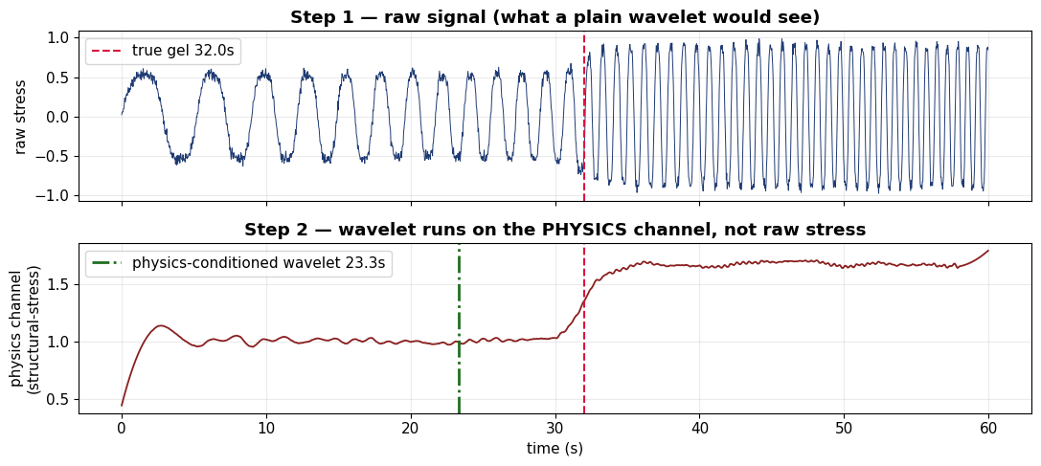
4.5
Phase 4.5 — Physics-Conditioned Wavelet
raw stress → physics channel → wavelet (chained, not A-vs-B)
The chain
STEP 1 — physics engineering:
viscosity = stress ÷ shear-rate
(or structural-stress envelope).
STEP 2 — wavelet on THAT channel,
not raw stress.
The wavelet hunts the transition in a signal that means 'how clotted is the blood.'
Real blood: median gap to the physical clot 11 s → 6 s.

Slide 9
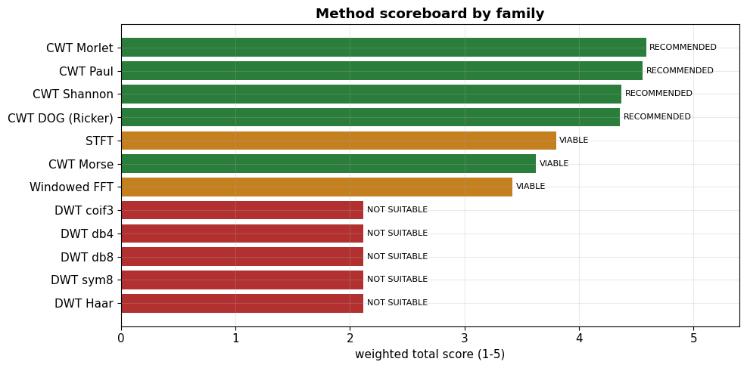
5
Phase 5 — Score the Methods
9 weighted criteria → ranked verdict

Slide 10
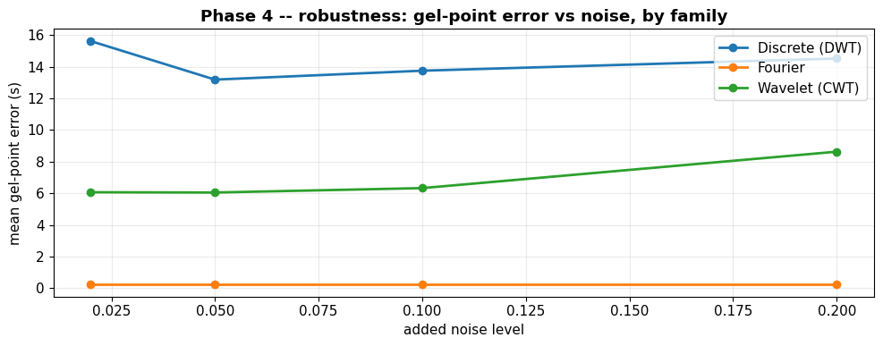
5
Phase 5 — Robustness Check
gel-point error vs added noise, by family
Reading it
Flatter + lower = copes with noise.
CWT stays low.
DWT stays high.
Confirms the ranking isn't a fluke of one noise level.

Slide 11
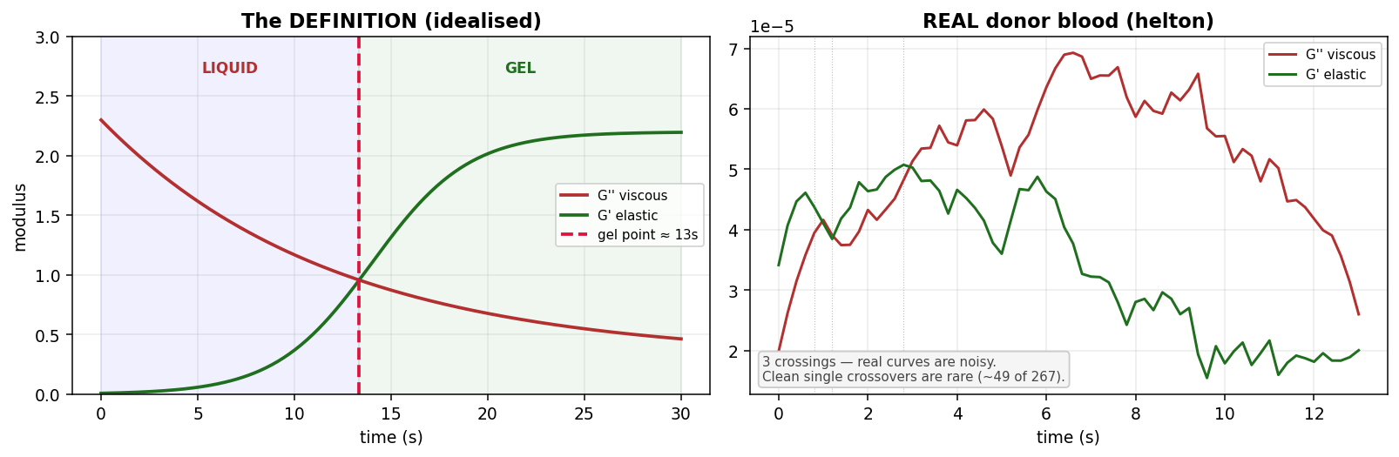
5
Phase 5 — Judge vs the Physical Gel Point
the gel point = G′/G″ crossover — idealised (left) vs real donor blood (right)
Judging
Left: the definition — G′ overtakes G″ at the gel point.
Right: REAL blood — the same moduli from actual stress & strain. Noisy, several crossings.
We take the first sustained liquid→gel crossing and check each detector against it.
Result: raw-wavelet wins 73, conditioned 44. Only ~49 signals give a clean crossover — stated openly.

Slide 12
6
Phase 6 — Pick the Winner & Deploy
winner read off the scoreboard, not hard-coded
CWT Morlet
SELECTED
4.59
CWT Paul
strong
4.55
STFT
limited
3.80
DWT
not suitable
2.02
13 candidates · scored on 9 criteria · top of the board deploys on real blood

Slide 13
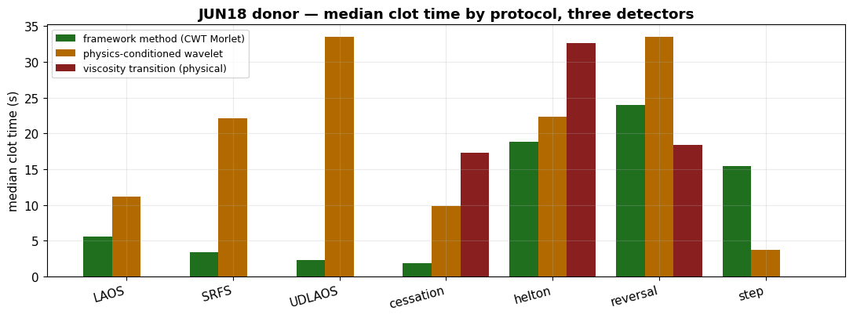
7
Phase 7 — One Donor: JUN18
per-protocol clot time, three detectors — a per-patient readout
Reading it
78 signals, 7 protocols.
Green = framework wavelet
Orange = physics-conditioned
Red = viscosity transition
Missing red = imposed-transient protocol with no physical clot (left blank, not faked).

Slide 14
Summary
G′/G″
224
4.59
6/6
gel point = the target
real signals analysed
CWT-Morlet, selected
health checks pass
The approach in one line
Define the gel point physically (G′/G″ crossover), build candidate detectors including a physics-conditioned wavelet, score them on nine criteria against both a known-answer synthetic clot and the real crossover, deploy the winner, and show it on one donor.

